Slide 1
Progress Briefing #3
Brady Vest, Maya Gardner, Tommy Liu

Slide 2
Goal Overview
Goal of this project: Wanting to identify explanatory factors of fosterage by incorporating variables of interest to the client
Goals for this update:
Prepare for further analysis by reorganizing, converting variables, and adding to our dataset.
Explore the generalized mixed effects model further by creating glmer models with a few hypotheses of interest determined by the client.

Slide 3
Goal 1: Prepare for further analysis by reorganizing and adding to our dataset
Identifying the first born child within our data
Our data only includes children 16 years or younger
first_born = 1 coincides with the oldest child for each mother
Go back to the raw dataset and add the new variable “first_born”
Incorporating other variables in our client’s hypothesis
Added 12 new variables
Many variables of interest to our client required some manipulation
For example: interested in mothers who got a higher education (used educational achievement level to get this)

Slide 4
Goal 2: Explore the generalized mixed effects model further by creating glmer models with a few hypotheses of interest determined by the client.
Our client provided us with 34 univariate hypotheses of interest
We were able to test 26/34 of them – 8 were not tested due to missing data
We used generalized mixed effects models (glmer) to do this

Slide 5
Reminders: Generalized Mixed Effects Models
Generalized Mixed Effects Models have:
Fixed Effects – terms for the independent predictor variables we are interested in
Random Effects – independent variables we know might contribute to variation but we don’t have a hypothesis for
When we add variables as random effects, the model can control for them (rather than test for them) – each of our individual tests must control for mother of the child

Slide 6
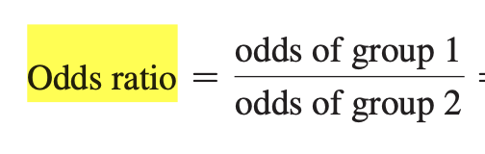
Odds Ratios
The odds (more specifically, odds of success) is used to compare proportions of success, and the odds ratio is used to compare the odds of two groups
The odds ratio is used to compare the relative odds of the occurrence of the outcome of interest (e.g. child fosterage), given exposure to the variable of interest (e.g. mother education level, marital status, etc)
OR=1 the odds for both groups are equal
OR>1 the odds for group 1 is higher than the odds of group 2
OR<1 the odds for group 1 is lower than the odds of group 2
Notes:
Odds = # success/#failures

Slide 7
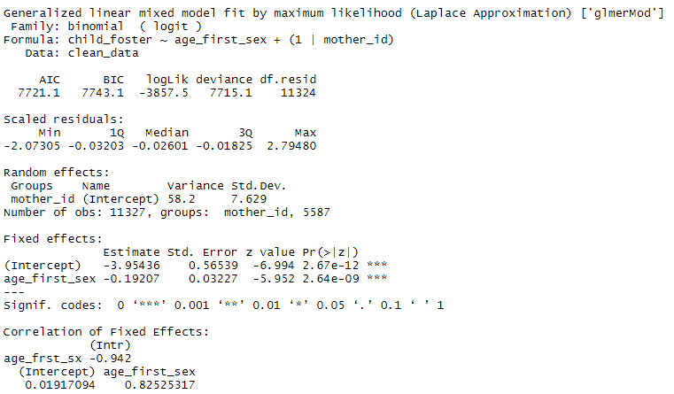
Hypothesis: Of all the women that have given birth, those who had sex for the first time at a younger age are more likely to have offspring living with someone else. As age increases, likelihood decreases.
Interpretation:
Regarding the age which a woman first has sex, a one year increase will reduce the odds of child fosterage by 18% roughly.
95% CI for estimate
(-0.255408, 0.128792)
95% CI for Odds Ratio
(0.7746004, 0.8791568)

Slide 8
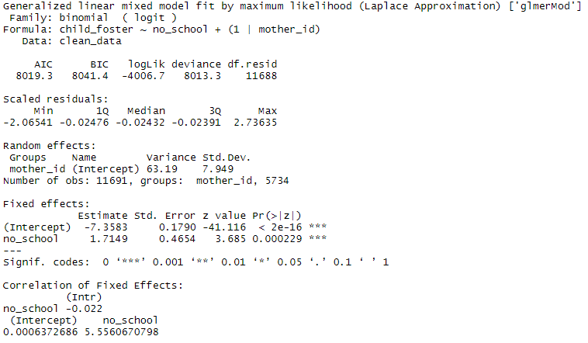
Hypothesis: Of all the women who have given birth, those that have never gone to school are more likely to have given up a child than women who have gone to school.
Interpretation:
The odds of child fosterage are 5.5561 greater for women who never attended school compared to women who attended any amount of school
95% CI for Estimate
(0.802716, 2.627084)
95% CI for Odds Ratio
(2.2316, 13.8334)

Slide 9
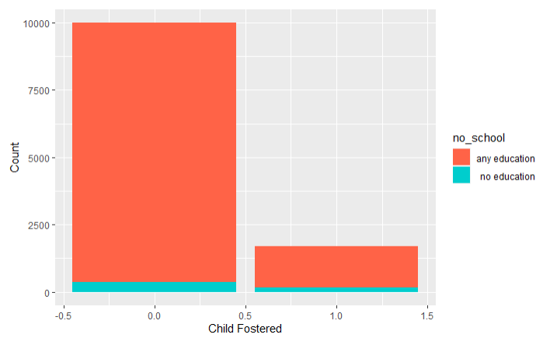
The odds of child fosterage are 5.5561 greater for women who never attended school compared to women who attended any amount of school
 | Child Not Fostered | Child Fostered
No Education | 367 | 151
Any Education | 9631 | 1542

Slide 10
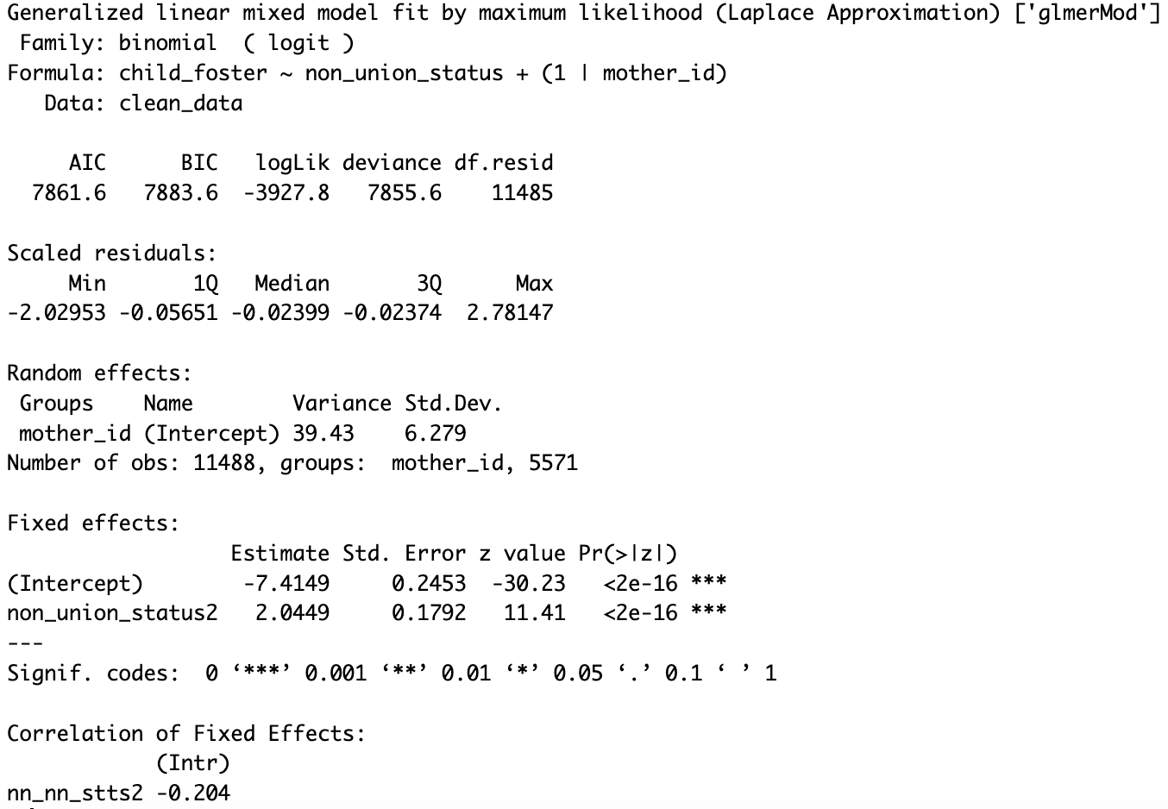
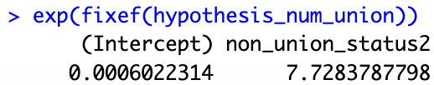
Hypothesis: Of all the women who have given birth, those who have lived with or been married more than once are more likely to have given up a child than women who have been married or been in a relationship once
Interpretation:
The odds of child fosterage are 7.73 times greater for women who married more than once than those who have married once
95% CI for Estimate
(1.693668, 2.396132)
95% CI for Odds Ratio
(5.439396, 10.98062)

Slide 11
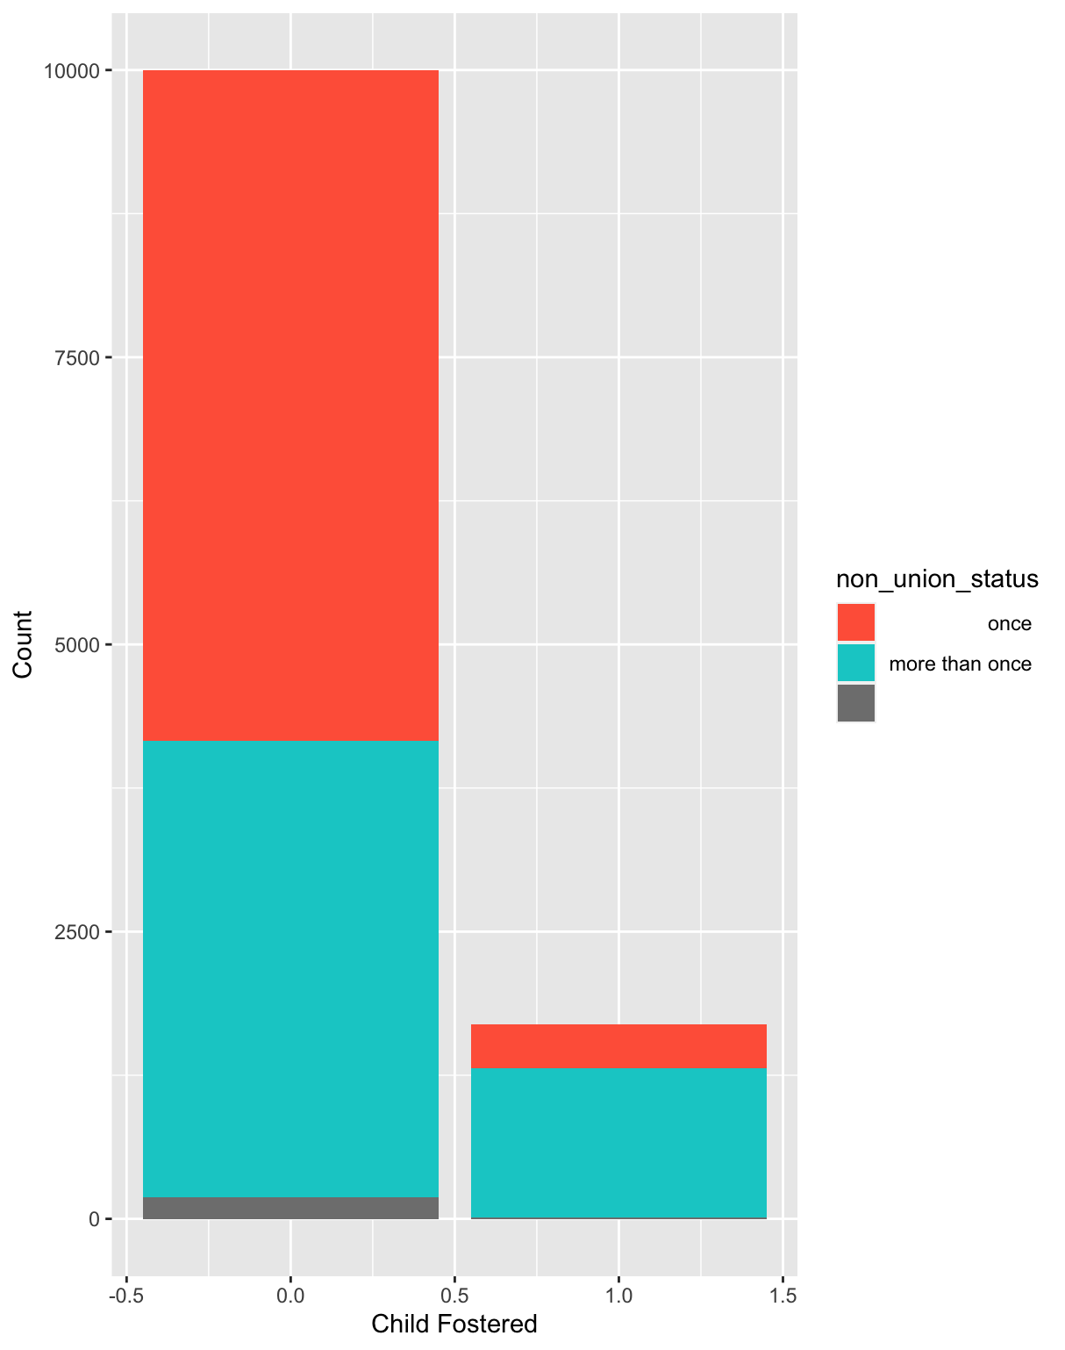
The odds of child fosterage are 7.73 times greater for women who married more than once than those who have married once
 | Child Not Fostered | Child Fostered
Once | 5837 | 380
More Than Once | 3970 | 1301

Slide 12
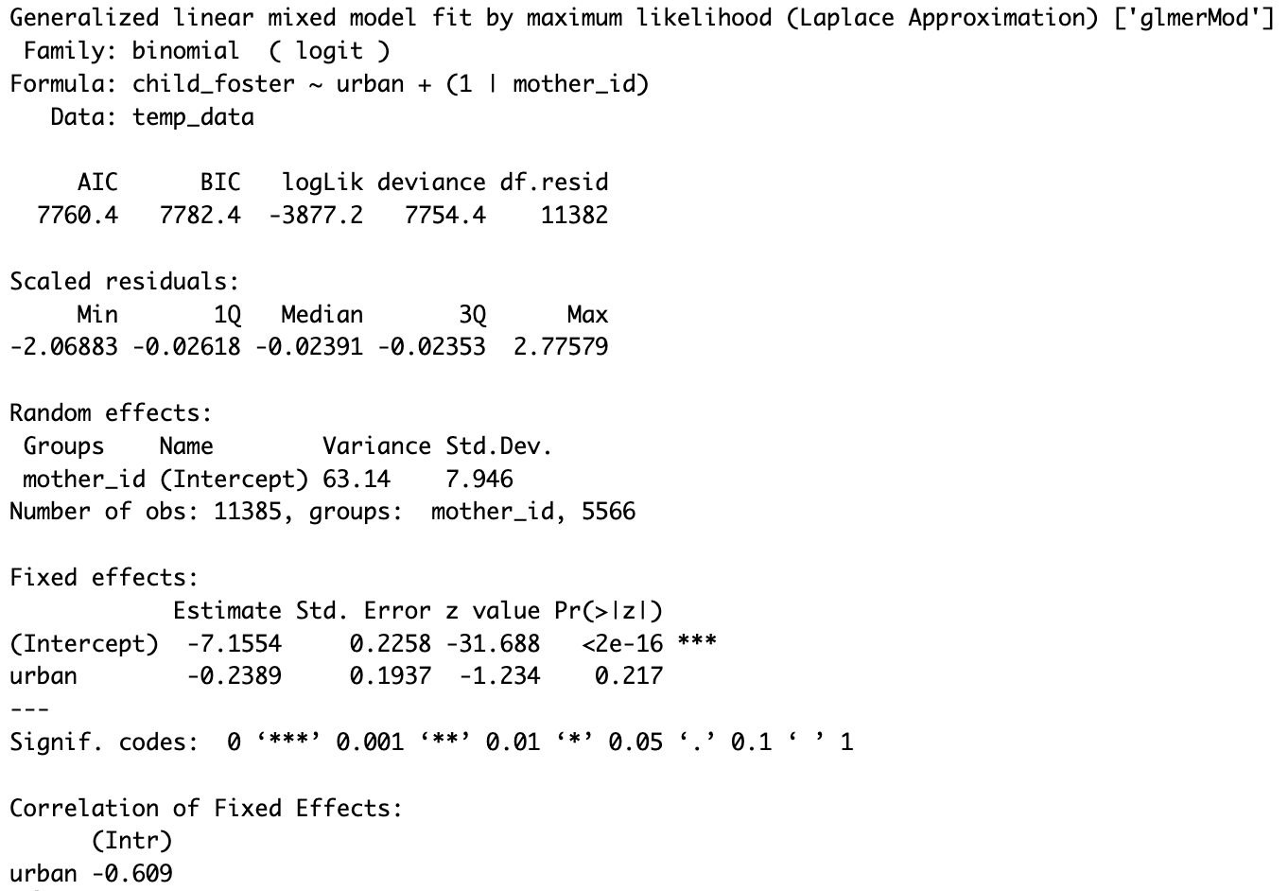
Hypothesis: Of all the women that have given birth, those that live in an urban area are more likely to have given up a child to be raised by others than women living in rural areas.
Odds of child fosterage for a woman living in an urban area are no different than a woman living in a rural area.
Odds Ratio: 0.7875
95% CI for odds ratio: (0.54, 1.15)
95% CI for estimate
(-0.6186, 0.1408)

Slide 13
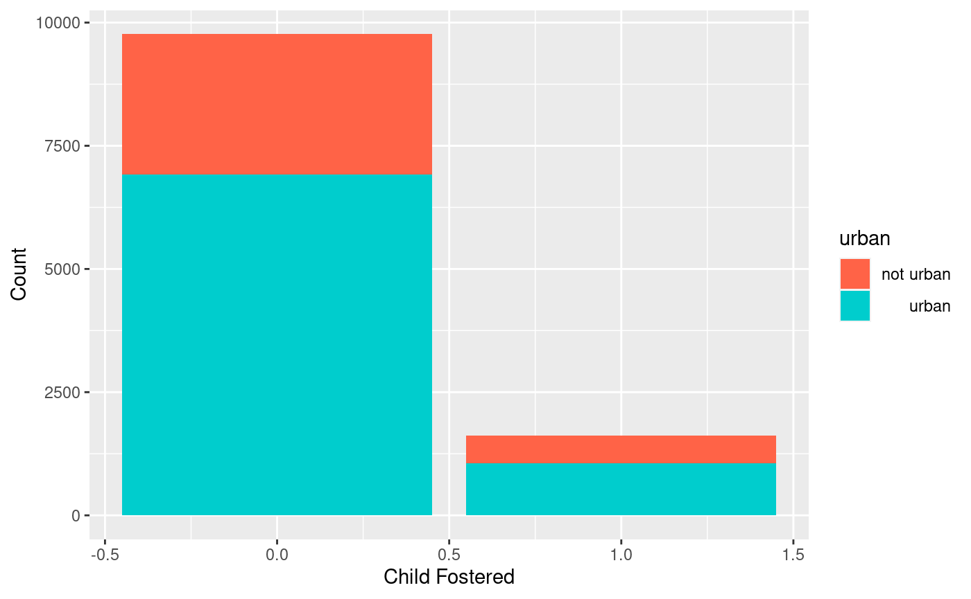
Odds of child fosterage for a woman living in an urban area is not different than a woman living in a rural area.
 | Child not fostered | Child fostered
Rural | 2843 | 568
Urban | 6922 | 1052

Slide 14
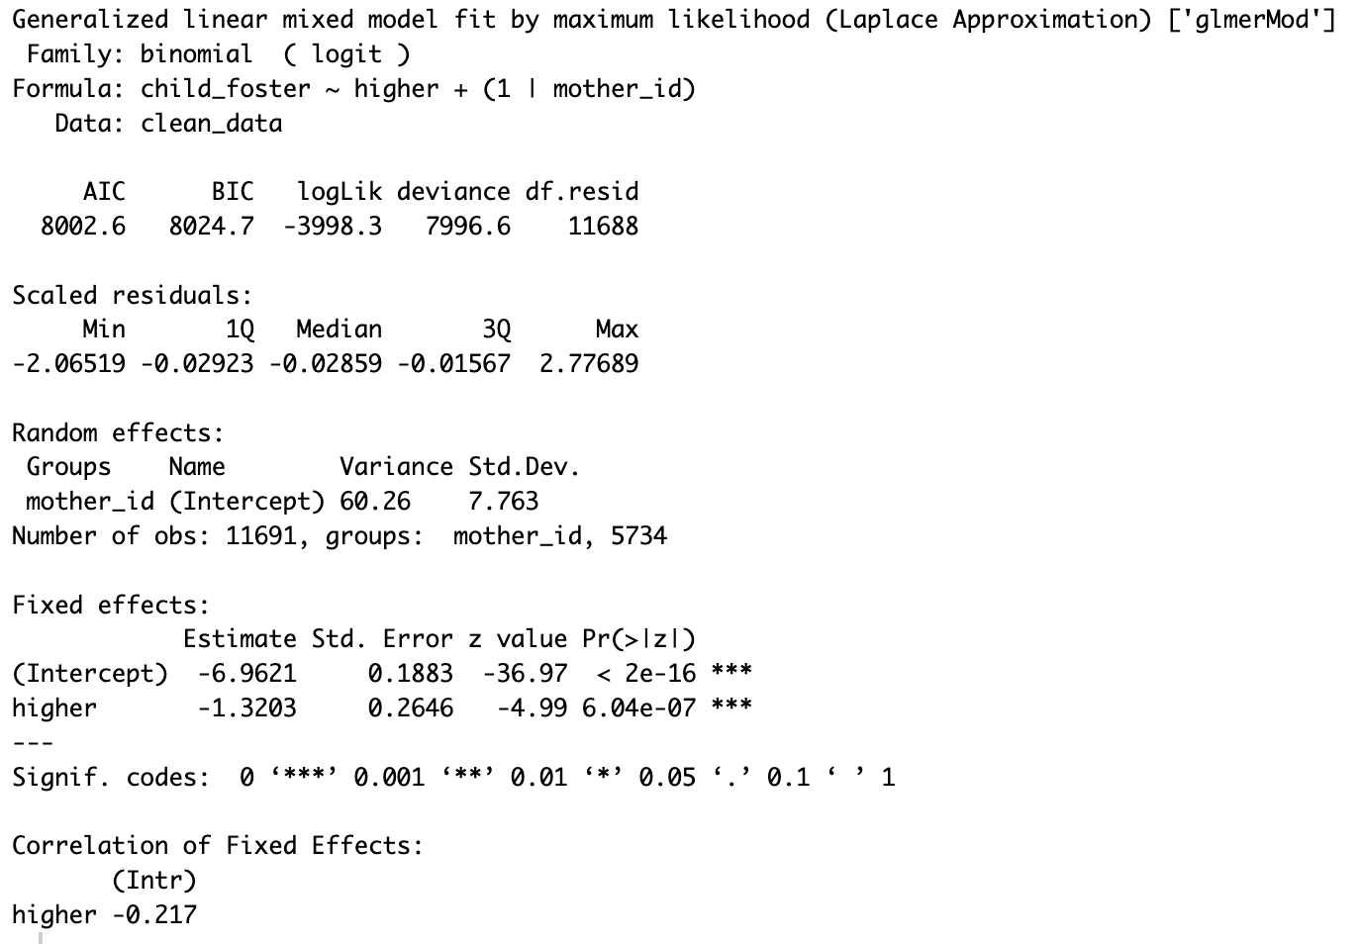
Hypothesis: Of all the women who have given birth, those that have achieved a higher level of education are less likely to have given up a child than women who have a lower level of education.
Odds of child fosterage for a woman with a higher level of education are 73% lower than for women with no higher level of education.
Odds Ratio: 0.2670
95% CI for odds ratio: (​​0.1590, 0.4486)
95% CI for estimate
(-1.8389, -0.8017)

Slide 15
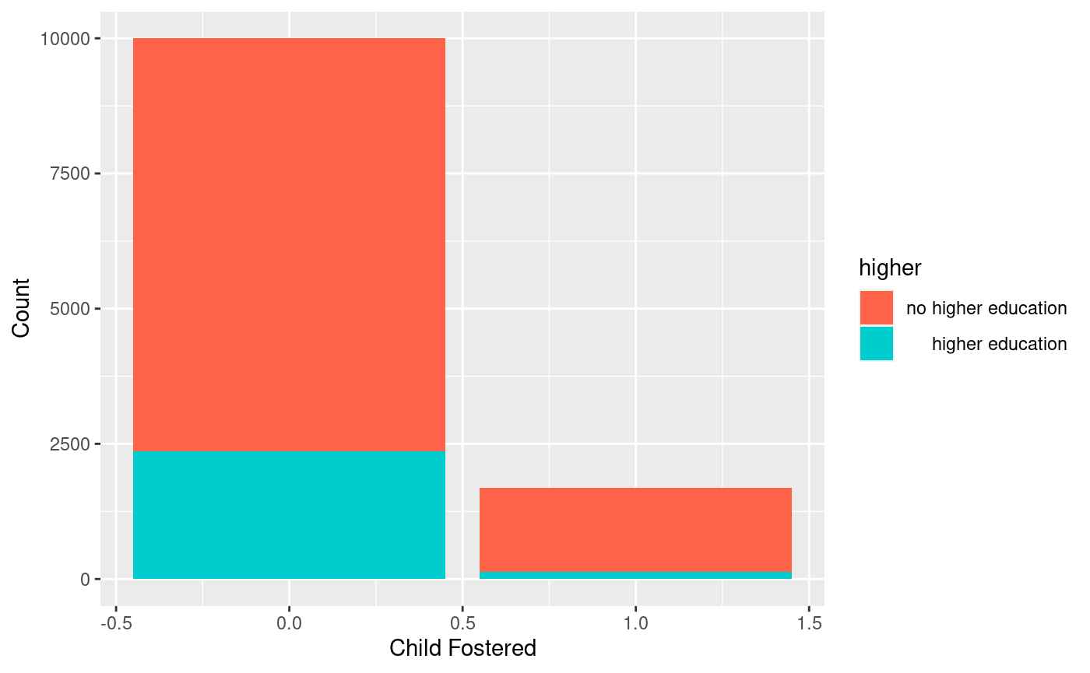
Odds of child fosterage for a woman with a higher level of education are 73% lower than for women with no higher level of education.
 | Child not fostered | Child fostered
No higher education | 7635 | 1556
Higher education | 2363 | 137

Slide 16
Next Steps
Investigate potential alternative hypotheses / variable proxies for hypotheses we could not answer due to N/A values
Begin to build a final and more comprehensive model by discussing and determining additional goals of the client and presenting this update with the class
Determine the best approach to modeling (and understanding of limitations)
Identify interaction terms of interest
Determining ways to visualize and model our data for our final products for the client by discussing with client/class/professor and starting preliminary modeling

Slide 18
Just a recap slide to use if necessary: glmer in lme4 package
lme4 functions follow the same Y ~ X formula notation as glm
Random effects: ( | )
Left: a term to modify the slope of the regression lines (we do not want to mess with this, so it will be 1)
Right: a term to modify the intercept of the regression lines, separated by the vertical bar
Will look something like this:
glmer(y ~ x1 + x2 + x3... + (1|RE),
data = NULL,
family = binomial))
Notes:
https://data.library.virginia.edu/getting-started-with-binomial-generalized-linear-mixed-models/
We account for these differences through the incorporation of random effects. Random intercepts allow the outcome to be higher or lower for each doctor or teacher; random slopes allow fixed effects to vary for each doctor or teacher.

